Slide 1
Stages in Data stage 8.7
Any use, copying or distribution without written permission from UnitedHealth Group is prohibited.

Slide 2

Change Capture Stage
The Change Capture stage compares two data sets and indicates the differences.
This operation produces a change data set, whose table definition is transferred from after data set’s table definition with addition of one column: a change code with values encoding the four actions: insert, delete, copy and edit.
The compare is based on a set of key columns, rows from the two data sets are assumed to be copies of one another if they have the same values in these key columns.
It can have a two input links and a single output link.

Slide 3
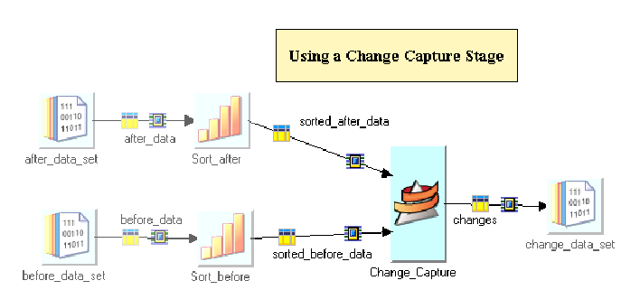
Change Capture Stage Usage

Slide 4
Change Capture Stage –
Change Code Values
The value of change code field can be one of the four codes:
Copy Code: If the after record is a copy of the before record then the value of change code is 0.
Deleted Code: If a record from before set is deleted from after set then the value of change code is 2.
Edit Code: If the after record is an edited version of the before record then the value of change code is 3.
Insert Code: If a new record has been inserted in the after set that did not exist in the before set then the value of change code is 1.

Slide 5
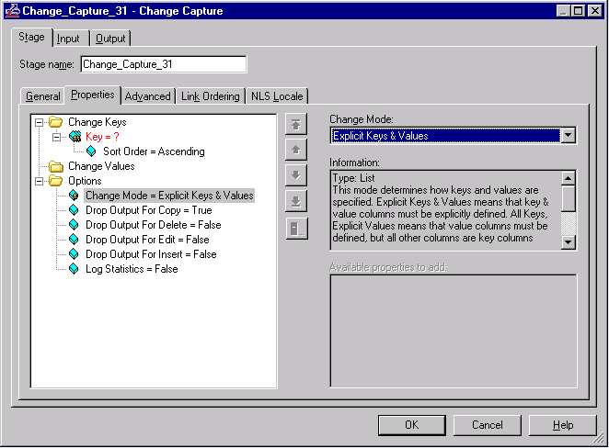
Change Capture Stage UI

Slide 6
Change Capture Stage – Sorting/Partitioning
The stage assumes that the incoming data is hash-partitioned and sorted in ascending order.
The columns the data is hashed on should be the key columns used for data compare.
The sorting and partitioning can be achieved by using the Sort stage or by using the built in sorting and partitioning abilities of the change capture stage.

Slide 7
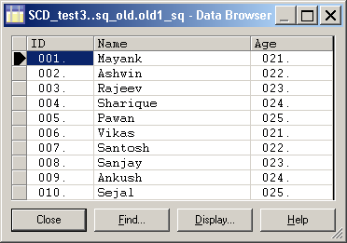
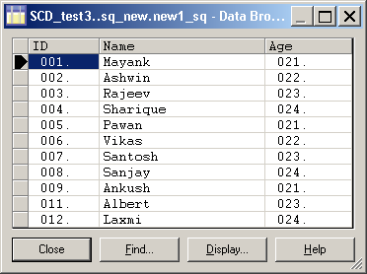
Change Capture Stage –
Example
Before Data Set
After Data Set
Five existing records are updated. ( ID: 005, 006, 007, 008, 009)
Two new records are inserted. (ID: 011, 012)
One record is deleted. (ID: 010)

Slide 8
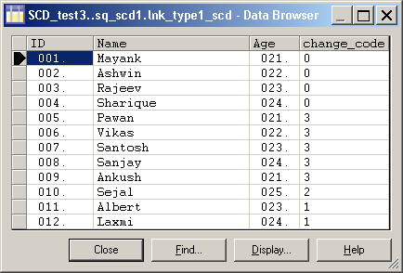
Change Capture Stage –Example
Change Code values for respective records:
Copy Code: Change Code value is 0.
Deleted Code: Change code value is 2.
Edit Code: Change code value is 3.
Insert Code: Change code value is 1.

Slide 9

Change Apply Stage
The Change Apply stage takes the change data set, that contains the changes in the before and after data sets, from the Change Capture stage and applies the encoded change operations to a before data set to compute an after data set.
The before input to Change Apply must have the same columns as the before input that was input to Change Capture.
The contents of the before input to Change Apply should be identical to the before input that was fed to Change Capture i.e. keys must be unique.

Slide 10
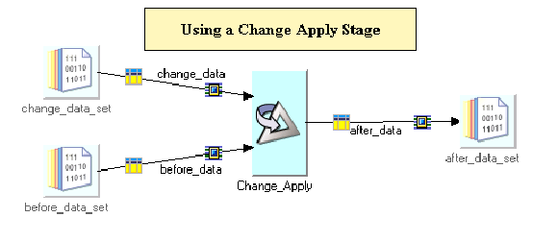
Change Apply Stage Usage

Slide 11
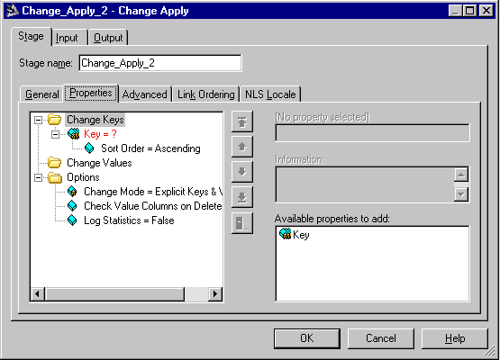
Change Apply Stage UI

Slide 12
Change Apply Stage – Partitioning
The change input to Change Apply must have been output from Change Capture without modification. Because preserve-partitioning is set on the change output of Change Capture.
There will be a warning at run time if the Change Apply stage does not have the same number of partitions as the Change Capture stage.
Both inputs of Change Apply are designated as partitioned using the Same partitioning method.

Slide 13

Compare Stage
The Compare stage performs a column-by-column comparison of records in two presorted input data sets. This comparison can also be restricted to specific key columns.
It transfers both data sets intact to a single output data set generated by the stage. The comparison results are also recorded in the output data set.
The Compare Stage does change the table definition, partitioning or content of the records in either input data sets.

Slide 14
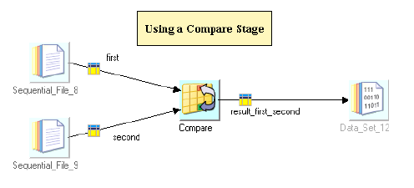
Compare Stage Usage

Slide 15
Compare Stage –
Output
Recommendation is to use run time column propagation in this
stage.
The stage outputs a data set (Run-time) with three columns:
result. Carries the code giving the result of the comparison.
first. A sub-record containing the columns of the first input link.
second. A sub-record containing the columns of the second input link.
If the output link Meta data is specified then, fully qualified names for the column definitions must be used (e.g. first.col1, second.col1 etc.), because DataStage does not allow two lots of identical column names.

Slide 16
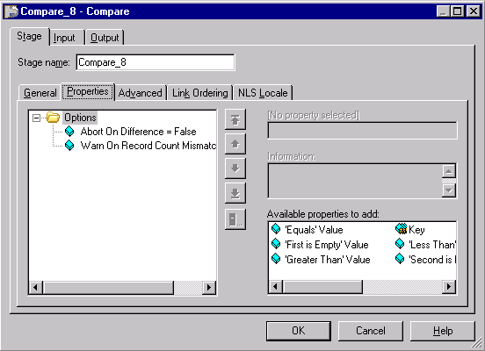
Compare Stage UI

Slide 17
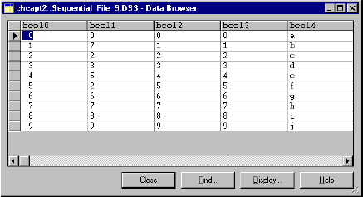
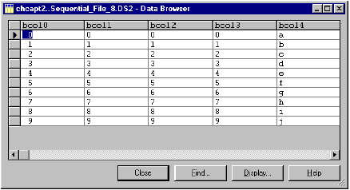
Compare Stage –
Example
First Data Set Second Data Set
This example shows two data sets being compared.

Slide 18
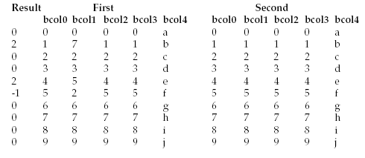
Compare Stage –Example
The stage compares on the Key columns bcol1 and bcol4. This is the output data set:

Slide 19

Difference Stage
The Difference stage performs record-by-record comparison of two input Data Sets, which are different versions of the same data set designated the before and after data sets.
The comparison is based on a set of difference key columns.
The Output is a single data set whose records represent the difference between them. The stage generates an extra column, DiffCode, which indicates the result of each record comparison.

Slide 20
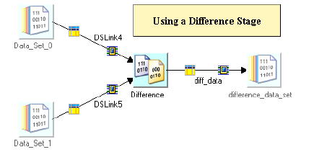
Difference Stage Usage

Slide 21
Difference Stage –Similar to Change Capture stage
The Difference stage is similar but not identical to Change Capture.
It outputs the before and after rows to the output data set, plus a code indicating if there differences.
Usually, the before and after data will have the same column names, in which case the data set effectively overwrites the before data set. And so only one set of columns is seen in the output.

Slide 22
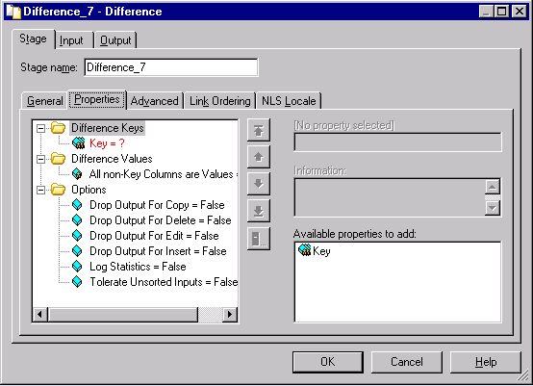
Difference Stage UI

Slide 23
Difference Stage –
Sorting/Partitioning
The stage assumes that the input data sets have been key-partitioned and sorted in ascending order on the key columns specified.
The sorting and partitioning can be achieved by using the Sort stage or by using the built in sorting and partitioning abilities of the Difference Stage.

Slide 24
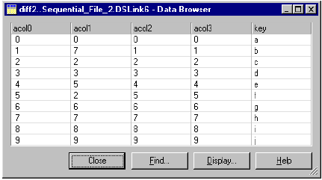
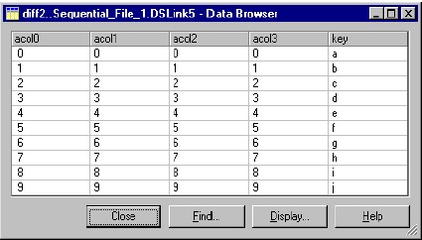
Difference Stage –
Example
Before Data Set After Data Set
The Example shows a before and after data set.

Slide 25
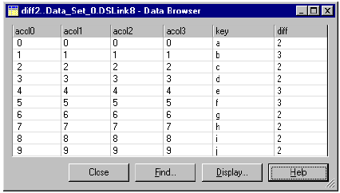
Difference Stage –
Example
This is the data set output by the Difference Stage.
The diff column indicates that rows b, e, f have been edited in the after data set.

Slide 26
Development/Debug Stages

Slide 27
Objectives
Understand DataStage EE Development /Debug Stages
Use this understanding to use these stages

Slide 28

Peek Stage
The Peek stage lets you print record column values either to the job log or to a separate output link as the stage copies records from its input data set to one or more output data sets.
This can be helpful for monitoring the progress of your application or to diagnose a bug in your application.
It can be used between two stages, to view the data in between stages. Also, it can be used as a stub/place holder as a last stage in your WIP job.
It has a single input link and any number of output links.

Slide 29
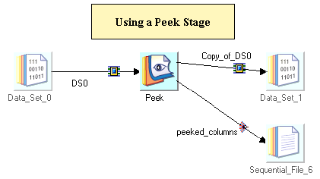
Peek Stage Usage

Slide 30
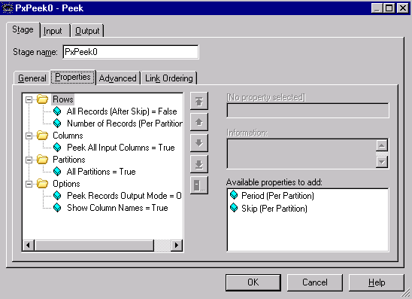
Peek Stage UI

Slide 31

Head Stage
The Head Stage selects the first N records from each partition of an input data set and copies the selected records to an output data set.
The records can be selected based on the following criteria:
  The number of records to copy
  The partition from which the records are copied
  The location of the records to copy
  The number of records to skip before the copying operation begins
This stage is helpful in testing and debugging applications with large data sets.
It can have a single input link and a single output link.

Slide 32
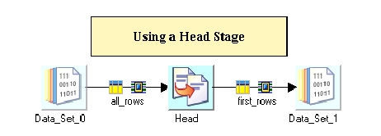
Head Stage Usage

Slide 33
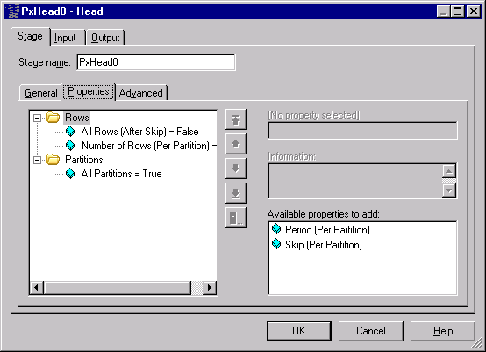
Head Stage UI

Slide 34
Head Stage Properties
The properties you can set are as follows:
Rows Category -
All Rows. Copy all input rows to the output data set. The Number of Rows property is not needed if All Rows is true.
Number of Rows (per Partition). Specify the number of rows to copy from each partition of the input data set to the output data set.
Period (per Partition). Copy every Pth record in a partition, where P is the period. P must equal or be greater than 1.
Skip (per Partition). Ignore the first number of rows of each partition of the input data set, where number is the number of rows to skip. The default skip count is 0.
Partitions Category -
All Partitions. If False, copy records only from the indicated partition, specified by number. By default, the operator copies rows from all partitions.
Partition Number. Specifies particular partitions to perform the Head operation on. You can specify the Partition Number property multiple times to specify multiple partition numbers. This is not needed when All Partitions is true.

Slide 35
Tail Stage
The Tail Stage selects the last N records from each partition of an input data set and copies the selected records to an output data set.
The records can be selected based on the following criteria:
  The number of records to copy
  The partition from which the records are copied
This stage is helpful in testing and debugging applications with large data sets.
It can have a single input link and a single output link.

Slide 36
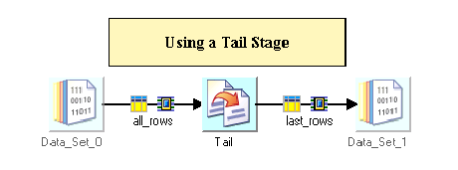
Tail Stage Usage

Slide 37
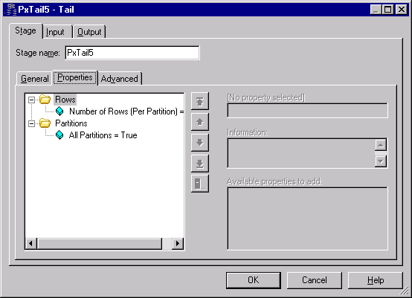
Tail Stage UI

Slide 38
Tail Stage Properties
The properties you can set are as follows:
Rows Category –
Number of Rows (per Partition). Specify the number of rows to copy from each partition of the input data set to the output data set.
Partitions Category –
All Partitions. If False, copy records only from the indicated partition, specified by number. By - default, the operator copies records from all partitions.
Partition Number. Specifies particular partitions to perform the Tail operation on. You can specify the Partition Number property multiple times to specify multiple partition numbers

Slide 39

Sample Stage
The Sample stage samples an input data set.
You can sample on a percentage of input rows (percent), or you can sample the Nth row of every partition (period).
It has a single input link and any number of output links.

Slide 40
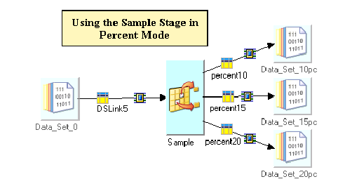
Sample Stage Usage

Slide 41
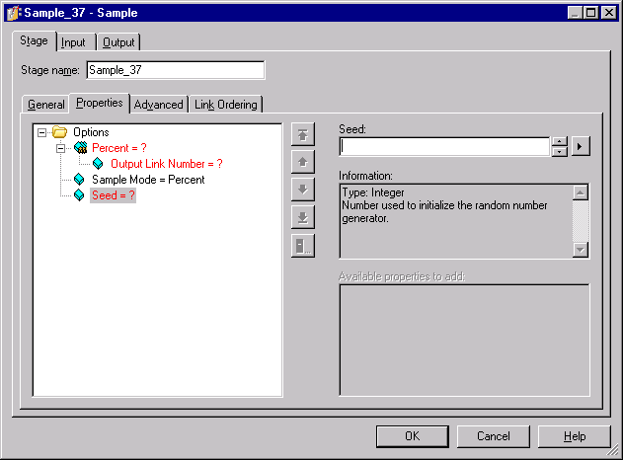
Sample Stage UI

Slide 42
Sample Properties
The properties you can set are as follows:
Sample Mode. Specifies the type of sample operation. You can sample on a percentage of input rows (percent), or you can sample the Nth row of every partition (period).
Percent. Specifies the sampling percentage for each output data set when use a Sample Mode of Percent. You can repeat this property to specify different percentages for each output data set. The sum of the percentages specified for all output data sets cannot exceed 100%.
Percent has a dependent property:
  Output Link Number. This specifies the output link to which the percentage corresponds.
  Seed. This is the number used to initialize the random number generator. This property is only available if Sample Mode is set to percent.
  Period (Per Partition). Specifies the period when using a Sample Mode of Period.
  Max Rows Per Partition. This specifies the maximum number of rows that will be sampled from each partition.

Slide 43

Column Generator Stage
The Column Generator stage adds columns to incoming data and generates mock data for these columns for each data row processed.
It works similar to Row Generator stage. It is suitable when you have data and extra columns need to be mocked/generated for those columns.
It can have a single input link and a single output link.
Note: Although this is a Development/Debug stage, it can be used in your final code also. Example: Hard coding data for a particular column, generating sequence numbers, etc.

Slide 44
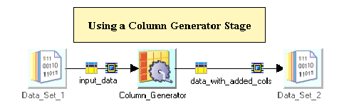
Column Generator Stage Usage

Slide 45
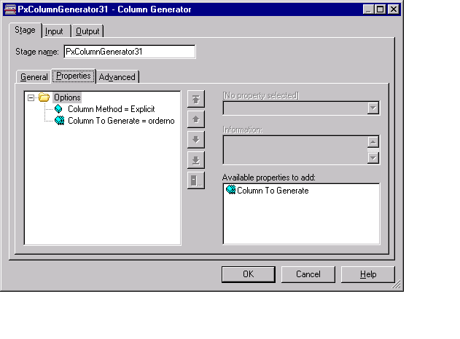
Column Generator Stage UI

Slide 46
Column Generator Properties
The properties you can set are as follows:
Column Method. Select Explicit if you are going to specify the column or columns you want the stage to generate data for. Select Schema File if you are supplying a schema file containing the column definition.
Column to Generate. When you have chosen a column method of Explicit, this property allows you to specify which output columns the stage is generating data for. Repeat the property to specify multiple columns.
Schema File. When you have chosen a column method of schema file, this property allows you to specify the column definitions in a schema file.

Slide 47

Write Range Map Stage
The Write Range Map stage allows you to write data to a range map. The stage can have a single input link.
It can only run in sequential mode.
The Write Range Map stage takes an input data set produced by sampling and sorting a data set and writes it to a file in a form usable by the range partitioning method. The range partitioning method uses the sampled and sorted data set to determine partition boundaries.
A typical use for the Write Range Map stage would be in a job which used the Sample stage to sample a data set, the Sort stage to sort it and the Write Range Map stage to write the resulting data set to a file.

Slide 48
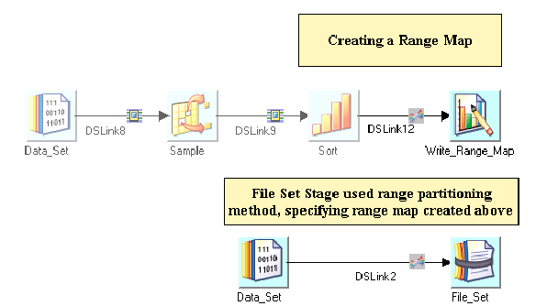
Write Range Map Stage Usage

Slide 49
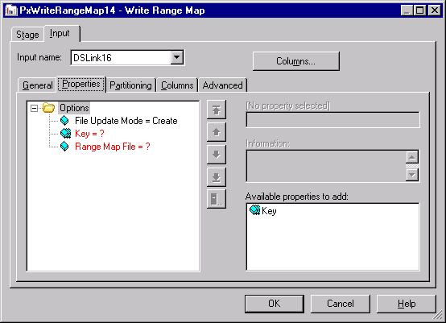
Write Range Map Stage UI

Slide 50
Write Range Map Properties
The properties you can set are as follows:
File Update Mode. This is set to Create by default. If the file you specify already exists this will cause an error. Choose Overwrite to overwrite existing files.
Key. This allows you to specify the key for the range map. Choose an input column from the drop-down list. You can specify a composite key by specifying multiple key properties.
Range Map File. Specify the file that is to hold the range map. You can browse for a file or specify a job parameter.

Slide 51
Development/Debug stages - Partitioning considerations
Following Development/Debug stages are default Parallel mode:
  Head stage
  Tail stage
  Peek stage
  Sample stage
  Column generator stage
So convert it to sequential when necessary.
Row Generator stage and Write Range Map stage are default Sequential.

Slide 52
DATABASE STAGES

Slide 53
Module Objectives
Introduction
Properties
Stage as a Source
Stage as a target
Advanced properties
Examples
Any use, copying or distribution without written permission from UnitedHealth Group is prohibited.

Slide 54

Oracle : Introduction
Oracle Stage
The Oracle Enterprise Stage is a database stage. It allows you to read data from and write data to an Oracle database.
The Oracle Enterprise Stage can have a single input link and a single reject link, or a single output link or output reference link.
The Oracle Enterprise Stage can also be used in conjunction with a Lookup stage to access a lookup table hosted by an Oracle database.
Any use, copying or distribution without written permission from UnitedHealth Group is prohibited.

Slide 55
Oracle : Stage Properties
The stage performs one of the following operations:
  Updates an Oracle table using INSERT and/or UPDATE as appropriate. Data is assembled into arrays and written using Oracle host-array processing.
  Loads an Oracle table (using Oracle fast loader).
  Reads an Oracle table.
  Deletes rows from an Oracle table.
  Performs a lookup directly on an Oracle table.
  Loads an Oracle table into memory and then performs a lookup on it.
When writing or loading, the Oracle Enterprise stage automatically converts DataStage data types to Oracle data types.
When reading, the Oracle Enterprise stage automatically converts Oracle data types to DataStage data types.
Any use, copying or distribution without written permission from UnitedHealth Group is prohibited.

Slide 56
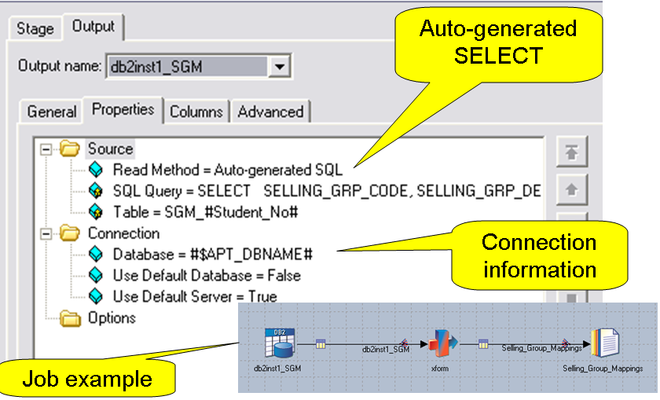
Oracle : Stage as a Source
Any use, copying or distribution without written permission from UnitedHealth Group is prohibited.

Slide 57
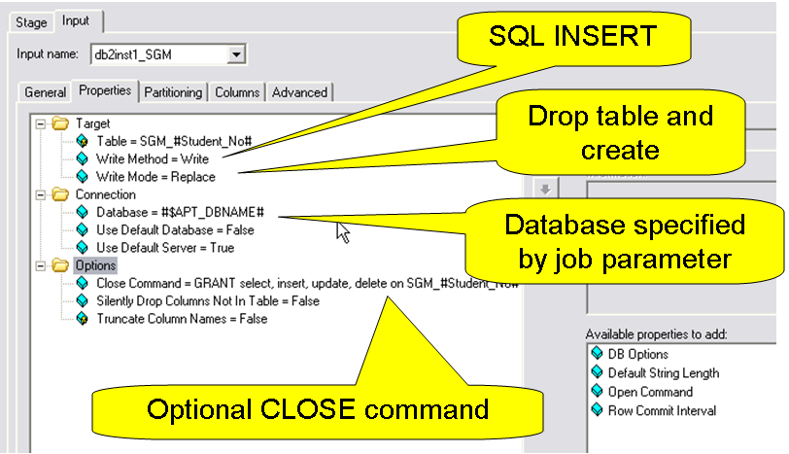
Oracle : Stage as a target
Any use, copying or distribution without written permission from UnitedHealth Group is prohibited.

Slide 58
Oracle : Advanced Properties
As a source
  Extract data from table (stream link)
      Read methods include: Table, Generated SQL SELECT, or User-defined SQL
      User-defined can perform joins, access views
  Lookup (reference link)
      Normal lookup is memory-based (all table data read into memory)
      Can perform one lookup at a time in DBMS (sparse option)
      Continue/drop/fail options
As a target
  Inserts
  Upserts (Inserts and updates)
  Loader
Any use, copying or distribution without written permission from UnitedHealth Group is prohibited.
Notes:
For clusterKeychange : Atleast one of the sort keys ‘Sort Mode’ should be set as Don’t Sort (Previously Sorted) or Don’t Sort (Previously Grouped), otherwise even if the clusterKeyChange column property is set to true DataStage would ignore it and would not create the clusterKeyChange Column in the ouput.

Slide 59
Oracle : Advanced properties
Write methods
  Delete
  Load
    Uses database load utility
  Upsert
    INSERT followed by an UPDATE
Write modes
  Truncate
  Create
  Replace
  Append
Any use, copying or distribution without written permission from UnitedHealth Group is prohibited.
Notes:
Sort Algorithm:
The Sort stage accumulates input rows in memory, limited by the Max Rows in Virtual Memory property. It sorts the accumulated rows, storing them in disk files, if necessary. (Small sort sets can be sorted in memory.) It merges these stored files and writes the rows to the output link.
The sort algorithm performs incremental sorts, This reduces the virtual memory usage and excessive page swapping that occurs when you have a large amount of input data associated with the input link.
Sort stage stores temporary files only on the scratch disks included in the sort scratch disk pool, if any are defined, and otherwise uses the default scratch disk pool.
When the parallel engine runs, it determines the locations of temporary files by:
1. Searching the parallel engine configuration for any scratch disk resources in the sort resource pool on the nodes sort will run on. If
found, the scratch disks are used as a location for temporary storage by sort.
2. If no scratch disk resources are found that belong to the disk pool sort, the system determines whether any scratch disk resources
belong to the default scratch disk pool on the nodes sort will run on. If so, the scratch disks belonging to the default pool are used
by tsort for temporary storage.
3. If no scratch disk resources are found that belong to either sort or the default scratch disk pool, the parallel engine issues a warning
message and runs sort using the directory indicated by the TMPDIR environment variable or /tmp for temporary storage.

Slide 60
Oracle : Advanced properties
The characters # and $ are reserved in DataStage and special steps are needed to handle Oracle databases which use the characters # and $ in column names. DataStage converts these characters into an internal format, then converts them back as necessary.
Any use, copying or distribution without written permission from UnitedHealth Group is prohibited.

Slide 61
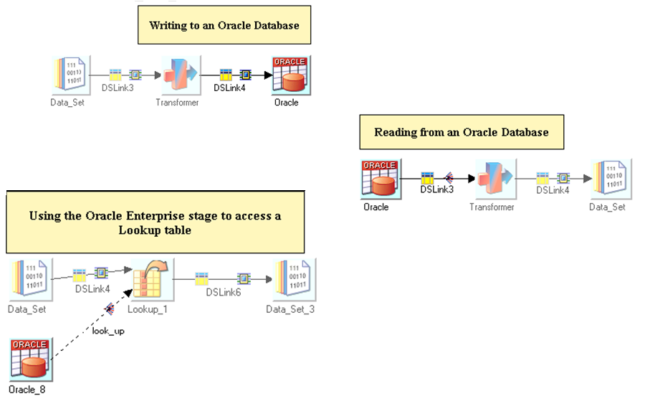
Oracle : Examples
Any use, copying or distribution without written permission from UnitedHealth Group is prohibited.

Slide 62
DB2ZLoad – Introduction
Used for Bulk Loading of Data using DataStage job running on non-z/OS platform.
Target stage of DB2Z stage suite.
Creates 4 datasets on z/OS system and uses these datasets to perform the load.
Generally 3 times faster than the DB2 API stage.
Any use, copying or distribution without written permission from UnitedHealth Group is prohibited.
Notes:
On the average, it takes about 10 minutes to load 1 million rows (1,600 rows per second) while DB2 API loads about 500 rows per second.
For this topic, it is assumed someone to be aware of the ETL fundamentals and a basic know-abouts of the Mainframe Datasets.

Slide 63
DB2ZLoad – Prerequisites
The use of the DB2ZLoad facility in Datastage requires the following:
z/OS version 1.8 or higher
DB2 for z/OS version 8.1 or higher
z/OS FTP server version 1.6 or higher
DataStage version 7.5.x or above
Any use, copying or distribution without written permission from UnitedHealth Group is prohibited.
Notes:
An FTP account is required on the mainframe.
2) The account needs to have write privilege to the project HLQ (High Level Qualifier). FTP account needs to be able to create and delete datasets under this HLQ.
3) A TSO ID on the mainframe. This account also needs to have read, write and delete privileges to the same HLQ
4) Database account that has “LOAD” and RUNSTATS privileges. This account is used when invoking the load utility on the mainframe.
5) DataStage patches – DB2ZLoad is an add-on to DataStage so it is not installed as part of the standard DataStage install but has to be installed separately by the DataStage Administrator.

Slide 64
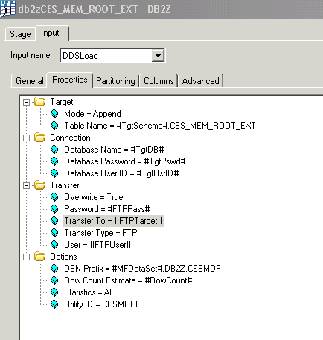
DB2ZLoad – Stage Properties
Any use, copying or distribution without written permission from UnitedHealth Group is prohibited.

Slide 65
DB2ZLoad – Stage Properties Cont…
Target category
  Table Name
  Required. This is the name of table in DB2 for z/OS to be loaded
  Mode
  Required. This property specifies whether all table rows should be deleted before the load (truncate) or not (append = the default).
Connection category
  Database Name
  Required. This is the name of the DB2 for z/OS database.
  Database User ID
  Required. This is the User Id which will be used to signon to the DB2 for z/OS database system.
Any use, copying or distribution without written permission from UnitedHealth Group is prohibited.
Notes:
DB2ZLoad partitions data into datasets based on the partitioning key of the target table, uses FTP to transfer the datasets to the mainframe and invokes the load command to load rows into the table
2) In general, DB2ZLoad performs the following functions:
• Prepares and partition source data into datasets
• Use FTP to send the datasets to the mainframe
• Optionally truncate the target table (for “truncate & load” method)
• Invokes the load command to insert the data
• Gather statistics on the newly loaded data
3) DB2ZLoad is a target stage so typically is the last stage in a job design.

Slide 66
DB2ZLoad – Stage Properties Cont….
  Database Password
    Required. This is the password which will be used to signon to the DB2 for
    z/OS database system.
Transfer Category
  Transfer Type
  Required. This is the name of the program used to transfer data to the z/OS machine.
  Transfer To
  Required. This is the hostname (or IP address) of the z/OS machine to which the data will be transferred in the form of Datasets.
  Transfer User
  This is the User ID which will be used in the FTP signon.
Any use, copying or distribution without written permission from UnitedHealth Group is prohibited.
Notes:
1) Valid options include “FTP” for standard file transfer protocol or “SFTP” for secured file transfer protocol. For UHG, FTP is the supported transfer mode to the mainframe.
2)

Slide 67
DB2ZLoad – Stage Properties Cont….
  Transfer Password
  Optional. This is the password which will be used in the FTP signon.
  Overwrite
  Optional. This property indicates whether or not to overwrite existing Datasets when transferring data (true) or not (false = the default). The default behavior is to not overwrite files, and if a job attempts to overwrite files and the value of this property is false, the job will terminate with an error.
  Character Set
  Optional. This property indicates the character set that will be used for transferring data.
Any use, copying or distribution without written permission from UnitedHealth Group is prohibited.
Notes:
ibm-1047-s390 character set
ustring data

Slide 68
DB2ZLoad – Stage Properties Cont….
Options category
  DSN Prefix
  Required. This is a string which will be used to construct names of MVS dataset.
  Row Count Estimate
  Optional. This property specifies an estimated count of the total number of rows to be loaded into all partitions combined. This estimate is used to calculate the amount of disk space which will be needed on z/OS for various datasets.
  Statistics
  Optional. This property is used to request that statistics be displayed at the end of the load.
Any use, copying or distribution without written permission from UnitedHealth Group is prohibited.
Notes:
1) SS3301.DB2Z.NDBFEE (SS3301 – DSN Prefix; HLQ)
2) Importance of Row Count Property – A parameter for performance setting
- DB2ZLoad stage uses this information to set the record length, number of blocks and cylinders.
- Developers may have to experiment with different values based on the size of the input data
Statistics: Type of statistics to be displayed in the DataStage job’s log. Options include “All”, “None”, “Table”, “Index”

Slide 69
DB2ZLoad – Stage Properties Cont….
  Utility ID
  Optional. This is an identifier used within the DB2 for z/OS system to identify this execution of the LOAD utility. Default value is “DB2ZLOAD “
  Verbose
  Optional. This property is used to request that additional informational and processing messages be displayed (true) or not (false = the default)
Any use, copying or distribution without written permission from UnitedHealth Group is prohibited.
Notes:
1) To request additional processing information to be included in the job log. Set to “True” in development and “False” in other environments
2) Why Utility ID is required:

Slide 70
DB2ZLoad Processing
MVS
DataStage Server
Dataset
DataStage Job
DSNUTILS
(Parallel load)
Job
Flow
FTP
…
…
FTP
  DB2Z Load Stage
  1. Transfer data to
  MVS Dataset
  2. Invoke DB2 Load
  using DSNUTILS
FTP
…
SQL CALL
Partitioned Table
DB2
Any use, copying or distribution without written permission from UnitedHealth Group is prohibited.

Slide 71
DB2ZLoad Processing Cont….
The DB2 for z/OS catalog (SYSIBM.SYS…) tables are interrogated to determine if and how the table is partitioned
For each table partition, an FTP process is created to transfer the data for that partition
All the data are transferred(FTP’ed) to datasets.
DB2ZLoad stage creates an appropriate LOAD statement for the parallel load, and invokes the DSNUTILS database procedure sending it the load statement statement
DSNUTILS will then initiate the DB2 LOAD utility
NOTE: LOAD cannot be run simultaneously with the FTP processes – it can be started only after all the FTPs are done
Any use, copying or distribution without written permission from UnitedHealth Group is prohibited.
Notes:
Each time the load job is started; these files will be overwritten to contain data for the current load. If for some reason, the load fails to run, developers should check and possibly delete all four files before running their load job in DataStage again.
If a run of DB2ZLoad failed, a subsequent run may fail with a message similar to this. Note that the DBA may have to be involved to help terminating the load and/or cleanup the issue in the database before the load can run again.
DSNUGUTC - UTILITY 'LOAD' INCONSISTENT WITH LAST INVOCATION
DSNUGBAC - UTILITY BATCH MEMORY EXECUTION ABENDED, REASON=X’00E40018’
These messages may indicate that a prior run of LOAD failed. DB2 remembers these runs and suspends them because there is a way you can restart them (manually). Since the DB2ZLoad facility does not support restart, you need to terminate the run in DB2.

Slide 72
DB2ZLoad Env. Variables
APT_RUN_DB2ZLOAD_SEQUENTIALLY
If the environment variable APT_DB2ZREAD_LOCK_TABLE is defined, DB2Z will use a one process to load the database. Even if the database table is partitioned, it will be loaded with a single process. Multiple processes will not be started for each partition
Any use, copying or distribution without written permission from UnitedHealth Group is prohibited.

Slide 73
DB2ZLoad Env. Variables Cont…
These four environment variables can be used to give you more control over how disk space is allocated when MVS datasets are used
APT_DB2ZLOAD_BYTESPERTRACK
APT_DB2ZLOAD_TRACKSPERCYL
APT_DB2ZLOAD_MAXBLOCKSIZE
APT_DB2ZLOAD_ALLOCTYPE
Any use, copying or distribution without written permission from UnitedHealth Group is prohibited.

Slide 74
DB2ZLoad Env. Variables Cont…
If you do not specify a value for a variable, the corresponding default value is used:
Bytes per track = 56664
Tracks per cylinder = 15
Max block size = 13682
Allocation type = CYL
(The value used for APT_DB2ZLOAD_ALLOCTYPE should be CYL or TRK.)
Any use, copying or distribution without written permission from UnitedHealth Group is prohibited.

Slide 75
DB2ZLoad Env. Variables Cont…
The computation of space is as follows:
Records per block = Max block size / Record size.
Block size = Record size * Records per block.
Number of blocks = Row count estimate / Records per block + 1
Note: Record size is computed based on the data types of the columns being loaded.
Any use, copying or distribution without written permission from UnitedHealth Group is prohibited.

Slide 76
DB2ZLoad Env. Variables Cont…
If Allocation type = TRK
Blocks per track = Bytes per track / Block size
Primary tracks allocated = Number of blocks / Blocks per track + 1
Secondary tracks allocated = Primary tracks allocated / 10
If Allocation type = CYL
Blocks per track = Bytes per track / Block size
Primary tracks allocated = Number of blocks / Blocks per track + 1
Primary cyl allocated = Primary tracks allocated / Tracks per cylinder + 1
Secondary cyl allocated = Primary cyl allocated / 10
Any use, copying or distribution without written permission from UnitedHealth Group is prohibited.

Slide 77
DB2ZLoad Limitations
DB2zLoad limitations:-
Partitioning keys of the following data types are supported: CHAR, VARCHAR, INTEGER, SMALLINT, FLOAT, REAL, DOUBLE, DATE, TIME, TIMESTAMP.
Database tables with CHAR or VARCHAR key column(s) which have limit values containing lower-case EBCDIC characters are not supported.
If you run DB2ZLoad using MVS datasets and if the table you’re loading is partitioned using table-controlled partitioning, an index is required on some column of the table. If an index is not defined on the table, DB2ZLoad may abend with following error:-
UNABLE TO OPEN DCB FOR DDNAME TMPL_WK2
UTILITY BATCH MEMORY EXECUTION ABENDED, REASON=X'00E40070'
Any use, copying or distribution without written permission from UnitedHealth Group is prohibited.
Notes:
1) To display suspended utility runs, enter this command:
/-DB2H DISPLAY UTILITY(*)
To terminate a utility run with utiliid=XXXXXX, enter this:
/-DB2H TERM UTILITY(XXXXXXXX)
To terminate all utility runs, enter this:
/-DB2H TERM UTILITY(*)
The developer’s TSO ID needs to have proper privileges to perform these commands.
2)

Slide 78

Unloading and Loading Technique used in Data stage
  DB2/UDB Enterprise Stage is a database stage
  The stage performs one of the following operations:
  Writes to a DB2 table (using INSERT).
  Updates a DB2 table (using INSERT and/or UPDATE as appropriate). Uses the DB2 CLI to enhance performance.
  Loads a DB2 table (using DB2 fast loader).
  Reads a DB2 table.
  Deletes rows from a DB2 table.
  Performs a lookup directly on a DB2 table.
  Loads a DB2 table into memory and then performs a lookup on it.
  The stage editor has up to three pages, depending on whether you are reading or writing a database:
  Stage page. This is always present and is used to specify general information about the stage.
  Input page. This is present when you are writing to a DB2 database. This is where you specify details about the data being written.
  Output page . This is present when you are reading from a DB2 database, or performing a lookup on a DB2 database. This is where you specify details about the data being read.
Any use, copying or distribution without written permission from UnitedHealth Group is prohibited.

Slide 79

New Improved Bulk loading Technique(DB2Z) in Data stage
DB2ZLOAD Utility used for bulk data load in DB2:
The stage performs one of the following operations:
  The Utility works in two mode “Append” and “Truncate”
  Loads a DB2 table (using Mainframe SDSNLOAD load Utility in background of the stage).
  Truncate huge volume of data in minutes.
  Ftp the data onto the Mainframe server and trigger the Mainframe JCL to load the data..
Property need to setup to execute the stage:
  Need to set the Mode Under Target.
  Need to set the ftp information in the stage about the Mainframe server under Transfer.
  Need to set the DSN Name (Dataset) in the stage with which dataset will be created at Mainframe side and is being used by SDSBLOAD utility to start the bulk load operation.
  Need to set the “Row estimate count and “Utility Id”, which depends on the volume of data need to be loaded and a Unique Utility id to kick the DB2 JCL in Mainframe system
Any use, copying or distribution without written permission from UnitedHealth Group is prohibited.

Slide 80
Advantages of using DB2Z stage
Improved Usability.
Greater performance, availability and scalability.
Cross loading of huge data.
Any use, copying or distribution without written permission from UnitedHealth Group is prohibited.

Slide 81

External Filter Stage
The External filter stage allows you to specify a UNIX command that acts as a filter on the data you are processing.
An example would be to use the stage to grep a data set for a certain string, or pattern, and discard records which did not contain a match.
This can be a quick and efficient way of filtering data.
It can have a single input link and a single output link.

Slide 82
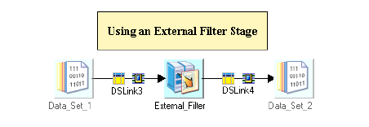
External Filter Stage Usage

Slide 83
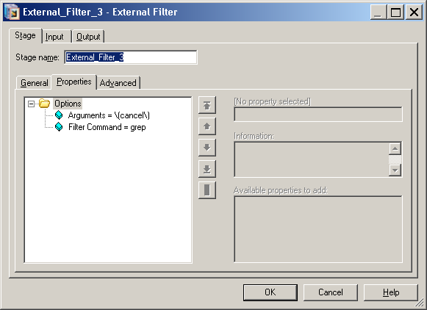
External Filter Stage UI - Properties
Example of grep command - It would extract all records that contained the string “(cancel)” and discard other records.

Slide 84

SAS Stage
The SAS stage allows you to execute part or all of an SAS application in parallel.
It reduces or eliminates the performance bottlenecks that might otherwise occur when SAS is run on a parallel computer.

Slide 85
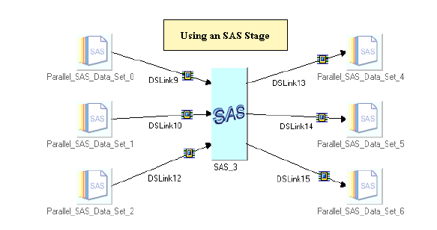
SAS Stage Usage

Slide 86
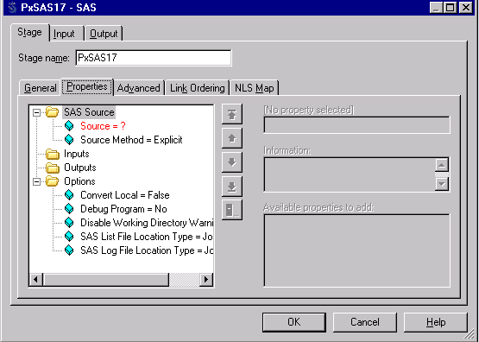
SAS Stage UI
Source Method. Choose from Explicit (the default) or Source File. You then have to set either the Source property or the Source File property to specify the actual source.
Source. Specify the SAS code to be executed. This can contain both PROC and DATA steps.
Source File. Specify a file containing the SAS code to be executed by the stage.

Slide 87
SAS stage - Advantages
Access, for reading or writing, large volumes of data in parallel from parallel relational databases, with much higher throughput than is possible using PROC SQL.
Process parallel streams of data with parallel instances of SAS DATA and PROC steps, enabling scoring or other data transformations to be done in parallel with minimal changes to existing SAS code.
Store large data sets in parallel, eliminating restrictions on data-set size imposed by your file system or physical disk-size limitations. Parallel data sets are accessed from SAS programs in the same way as conventional SAS data sets, but at much higher data I/O rates.
Realize the benefits of pipeline parallelism, in which some number of SAS stages run at the same time, each receiving data from the previous process as it becomes available.

Slide 88

Compress Stage
The Compress stage uses the UNIX compress or GZIP utility to compress a data set.
It converts a data set from a sequence of records into a stream of raw binary data.
A compressed data set is similar to an ordinary data set and can be stored in a persistent form by a Data Set stage, but it cannot be processed by many stages until it is expanded.
As compressing a data set removes its normal record boundaries, the compressed data set must not be repartitioned before it is expanded.
It can have a single input link and a single output link.

Slide 89
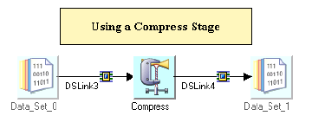
Compress Stage Usage

Slide 90
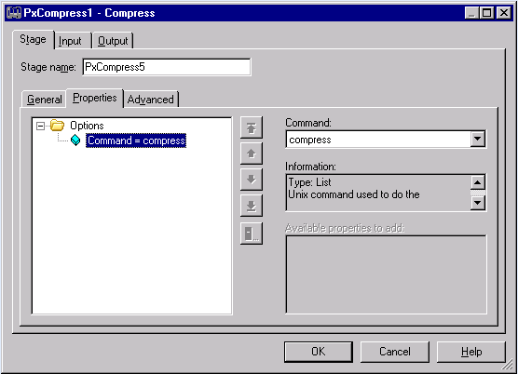
Compress Stage UI

Slide 91

Expand Stage
The Expand stage uses the UNIX uncompress or GZIP utility to expand a data set.
It converts a previously compressed data set back into a sequence of records from a stream of raw binary data.
It can have a single input link and a single output link.

Slide 92
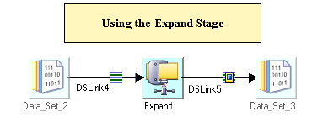
Expand Stage Usage

Slide 93

Expand Stage UI

Slide 94

Encode Stage
The Encode stage encodes a data set using a UNIX
encoding command, such as gzip.
This stage converts a data set from a sequence of records into a stream of raw binary data.
The Output of Encode stage can be written to any data set, but this data set can not be used as an input to stages that perform column-based processing or re-orders rows.
As the output is always a single stream, it is not required to define meta data for the output link.

Slide 95
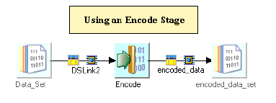
Encode Stage usage

Slide 96
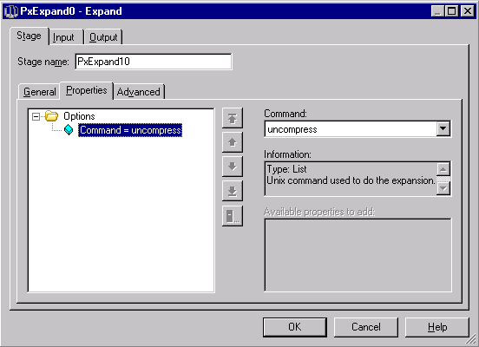
Encode Stage UI

Slide 97
Encode Stage –
Partitioning
The Encoded Data Set can not be repartitioned, there will be a warning at runtime if the job attempts to do the same.

Slide 98

Decode Stage
The Decode Stage decodes a data set using a UNIX
decoding command, such as gzip.
This Stage converts a data stream of raw binary data into a data set.
As the input is always a single stream, it does not require to define meta data for the input link.
Its companion stage, Encode, converts a data set from a sequence of records to a stream of raw binary data.

Slide 99
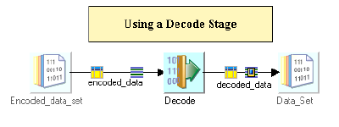
Decode Stage Usage

Slide 100
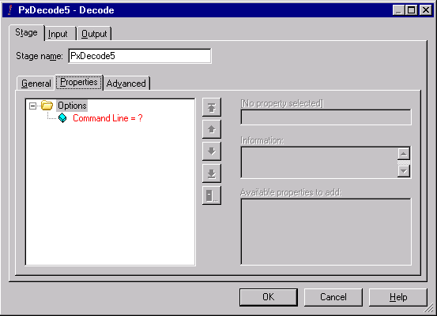
Decode Stage UI

